Slide 1
Project Management for Third Eye for Blind People

Slide 2
Name | ID
Gehad Hussien Saleh | 20183563
Mahmoud Khaled Kamal | 20184434
Nada Wael Mohamed | 20181435
Muhamed Abdelgelil | 20184997
Sama Mohamed Nasr | 20181995

Slide 3
Problem Description
This project introduces an aid impaired people system which help blind people to recognize current object. Visually impaired people are usually un-realizable of the danger that they face in their daily life. They may face many obstacles when performing their daily activity. Objects detected are represented by their names and converted to audio. It helps impaired people to detect and recognize the tools around them, which they see through a mobile camera. It uses an intelligent architecture system to develop a system to recognize indoor objects and provide the output into a voice message. The intelligent system imitating the human eye. A mobile camera captures an image, serves as input to deep learning model, which has the object detection. The Output will be audio.

Slide 4
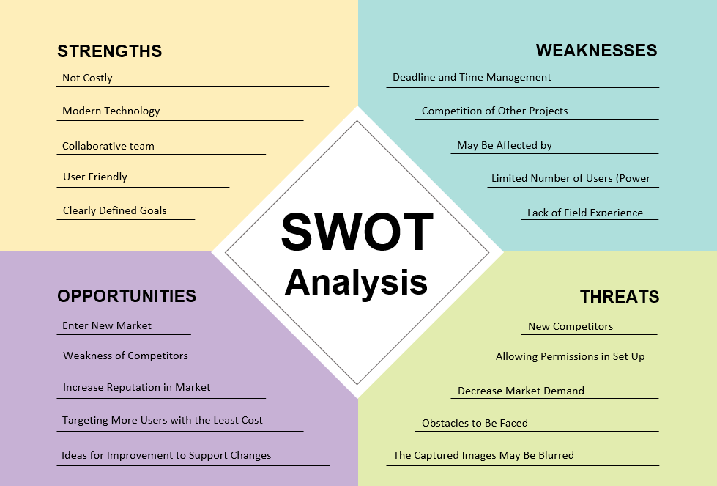

Slide 5
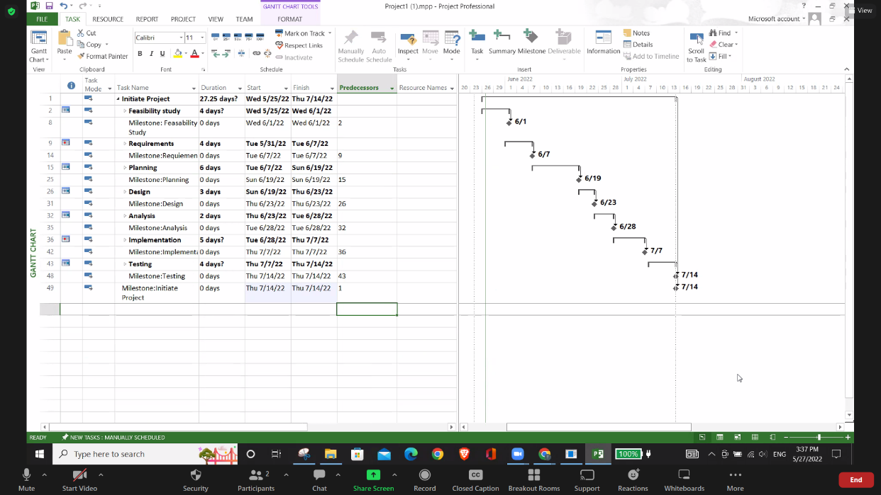
1

Slide 6
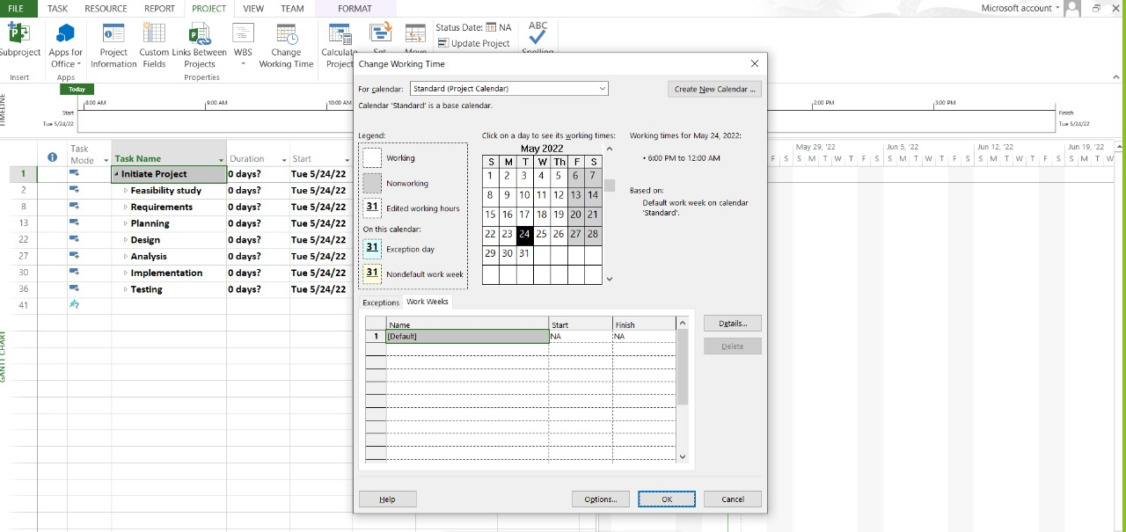
2

Slide 7
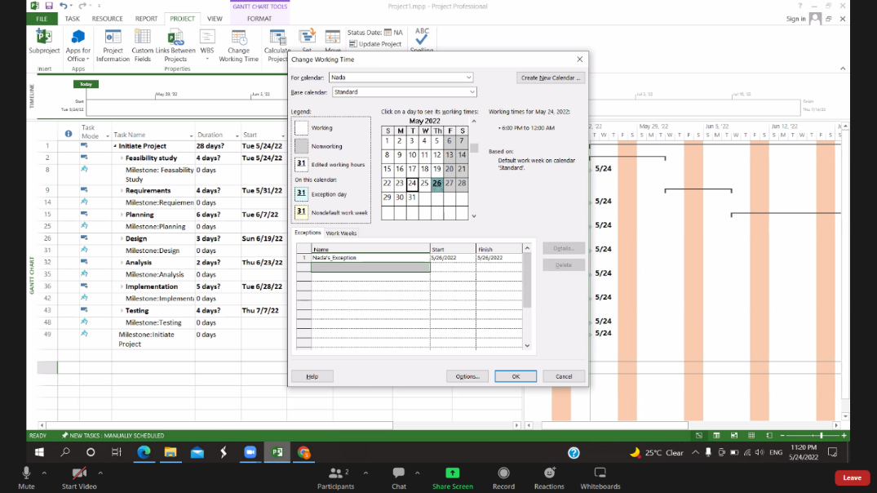
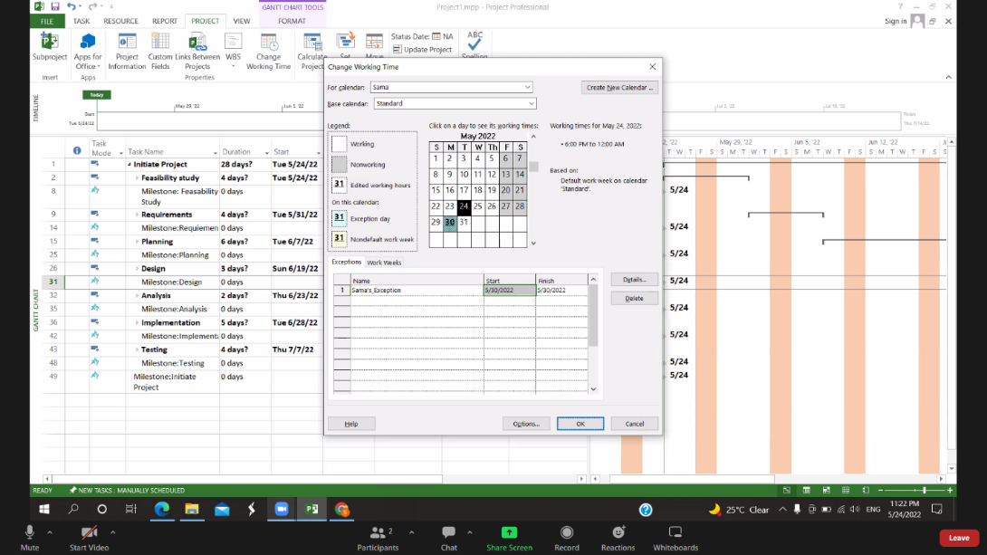
2

Slide 8
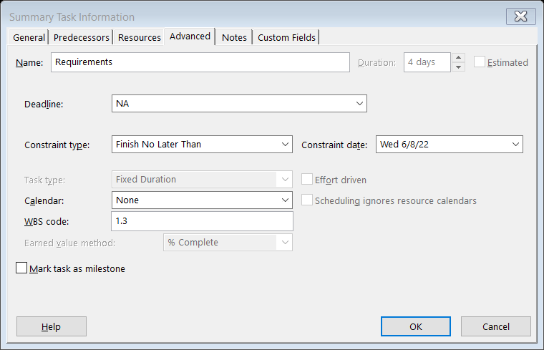
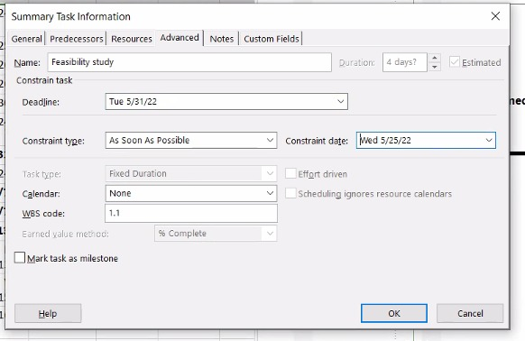
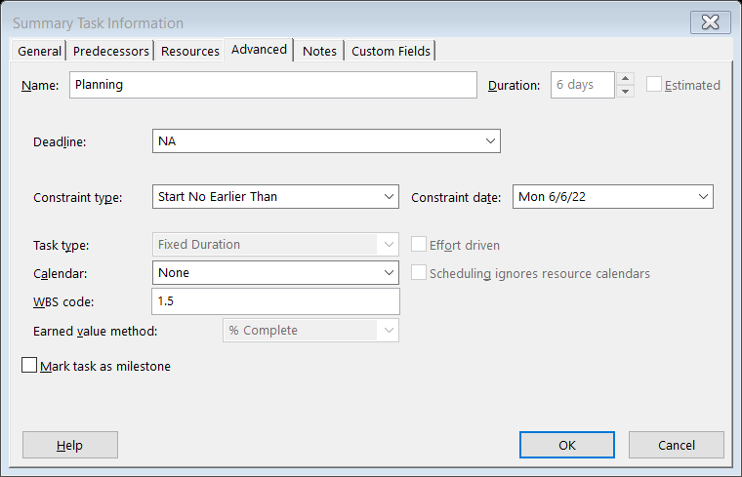
3

Slide 9
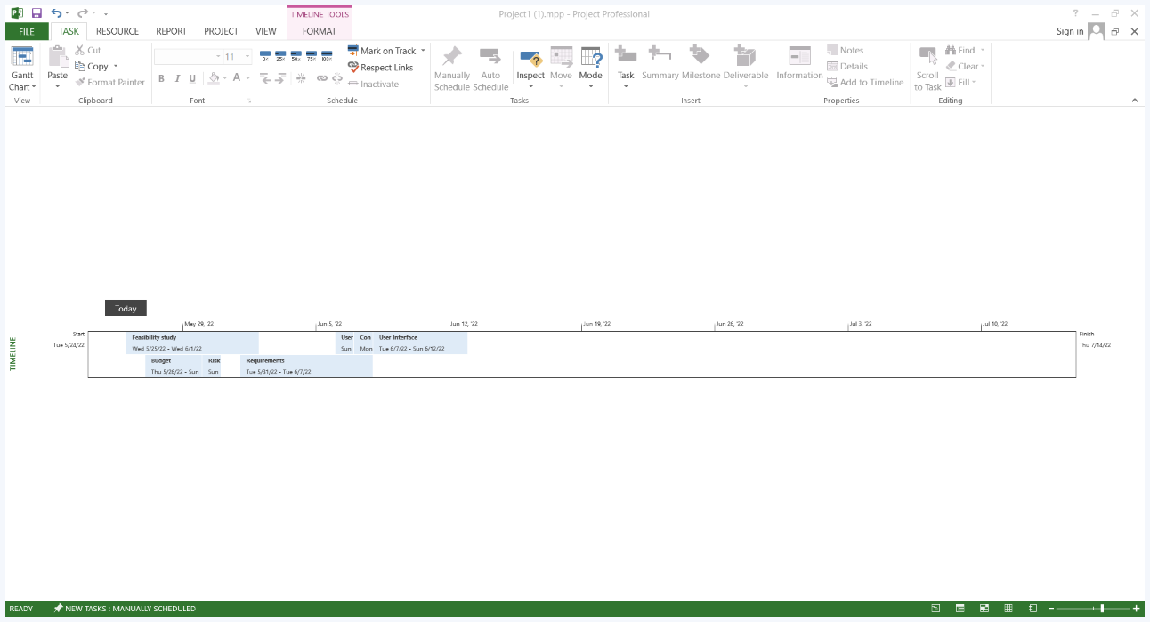
4

Slide 10
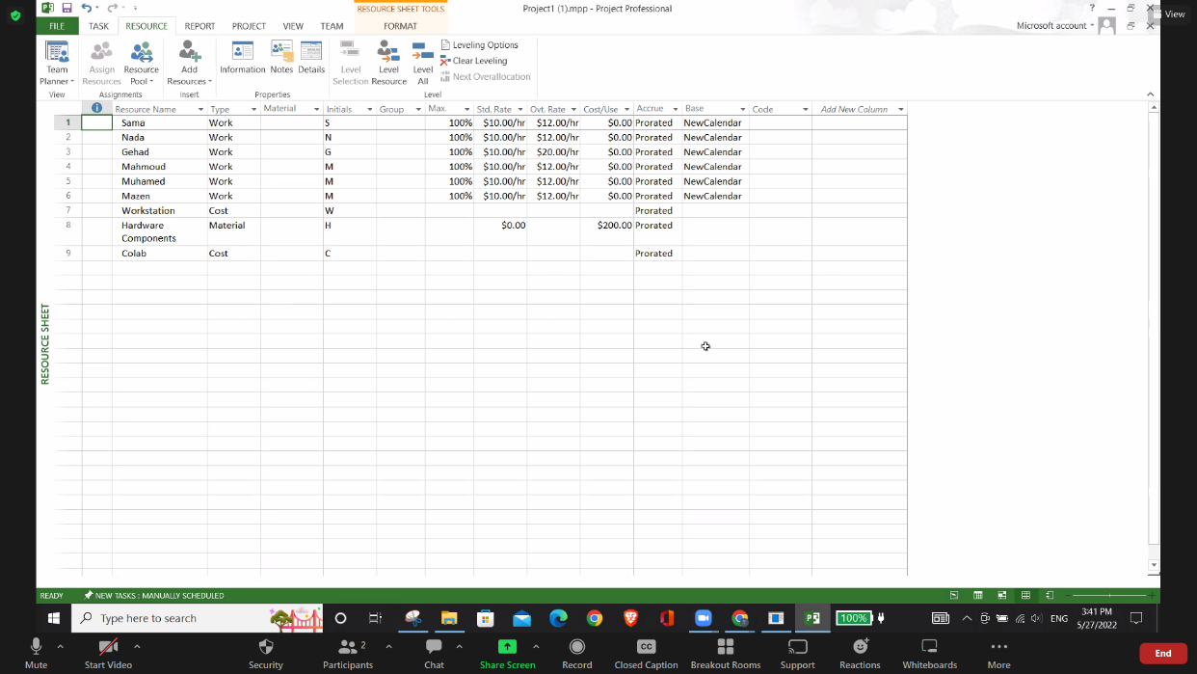
5

Slide 11
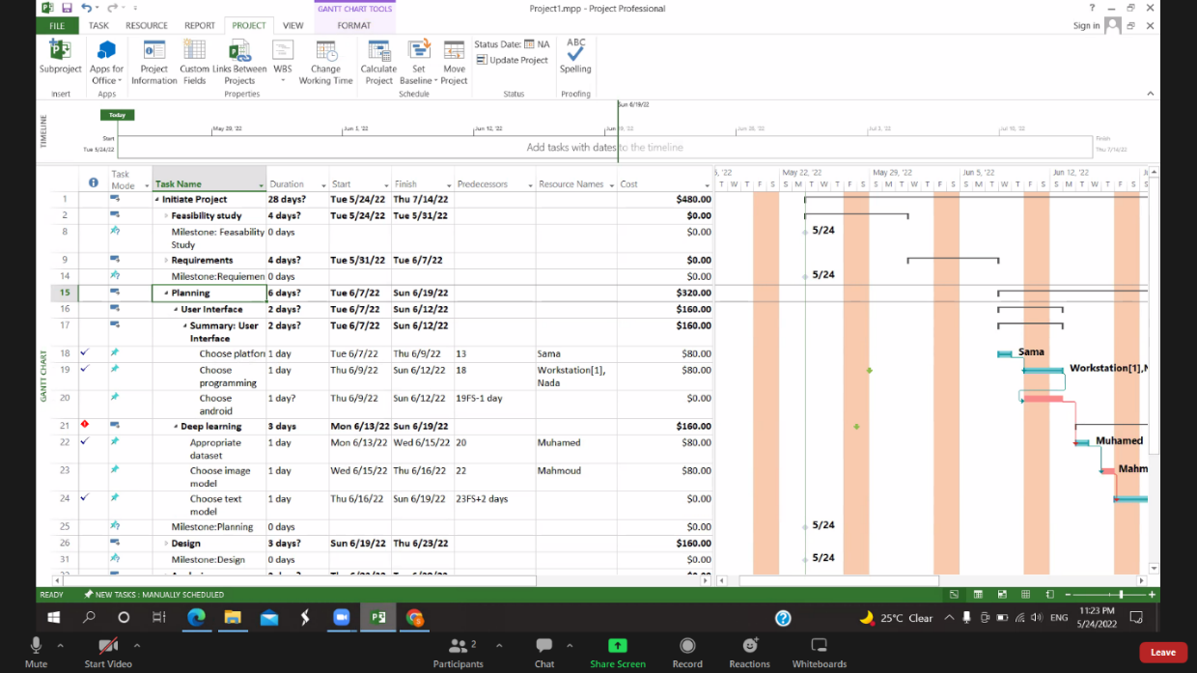
6

Slide 12
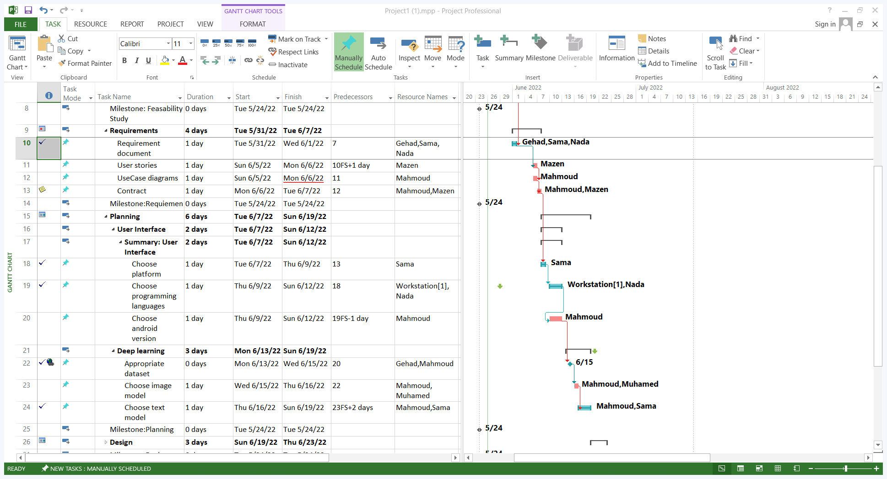
7

Slide 13
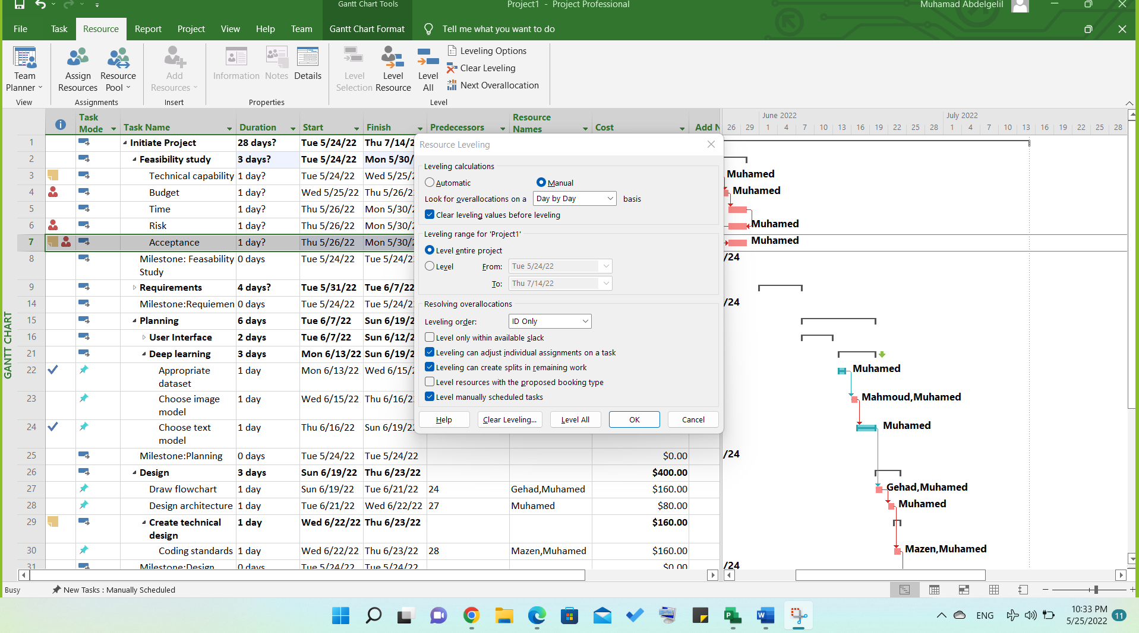
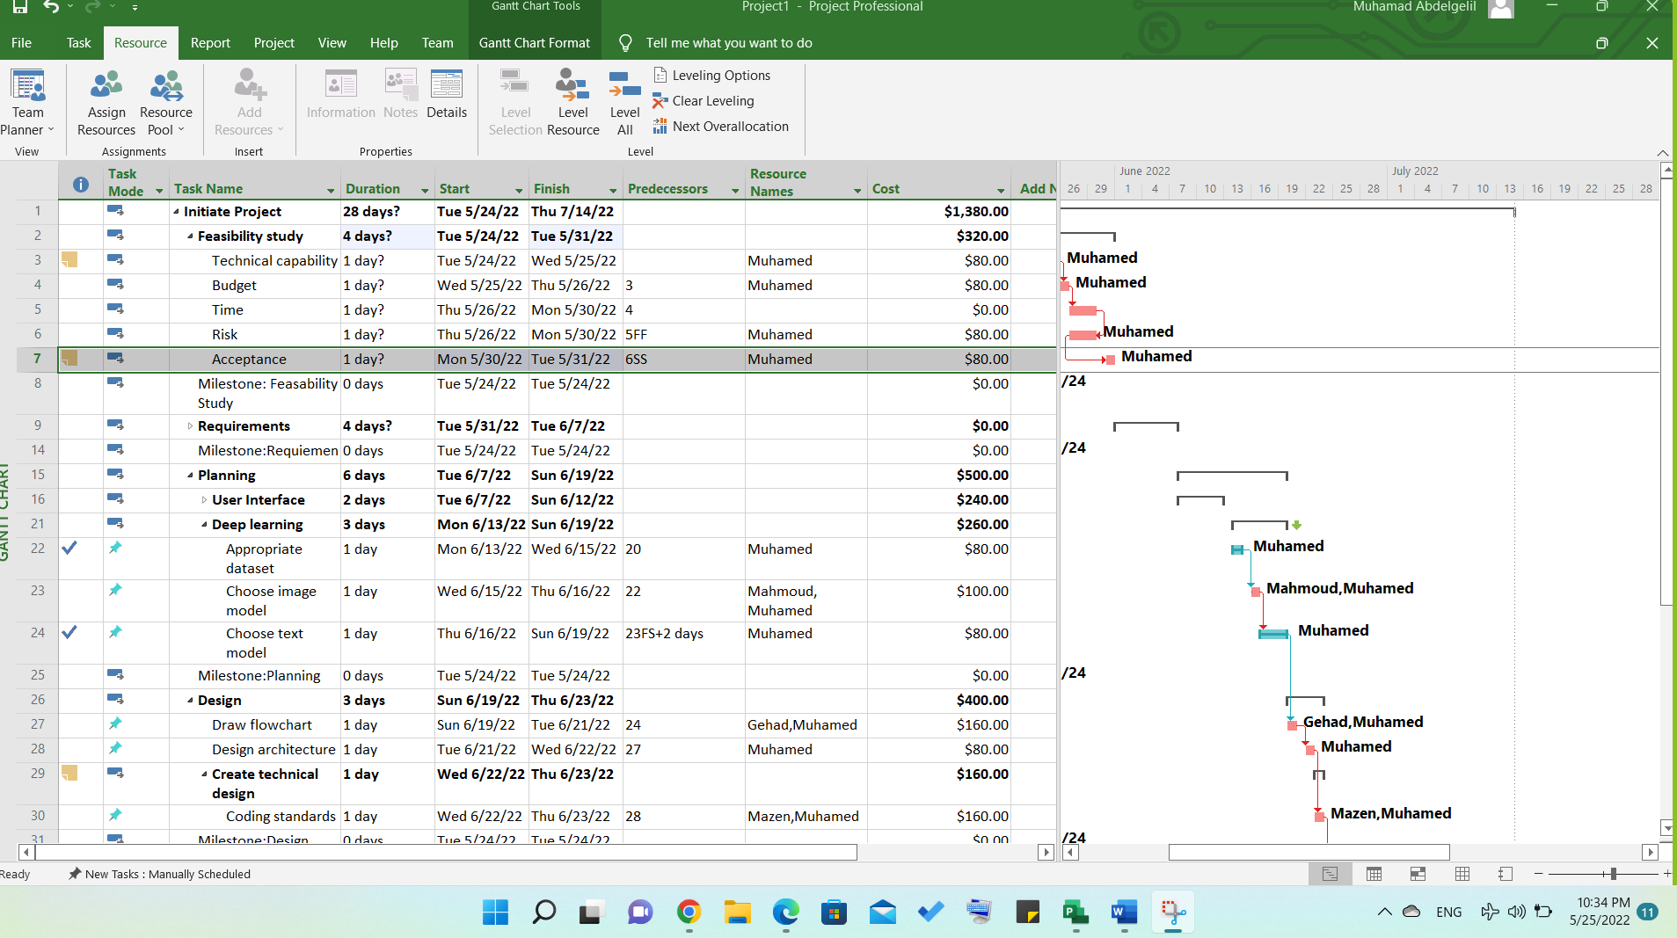
8

Slide 14
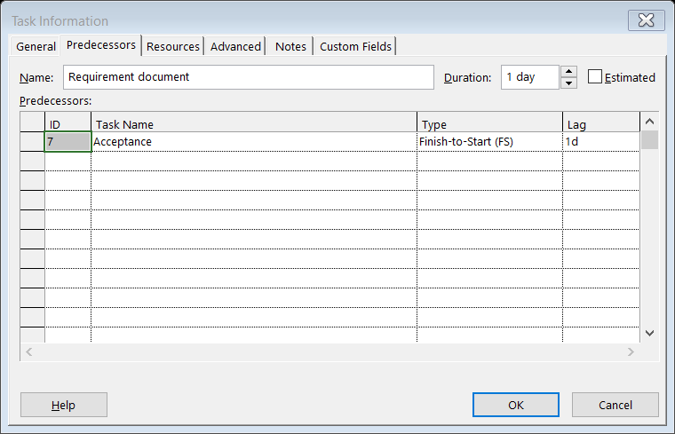
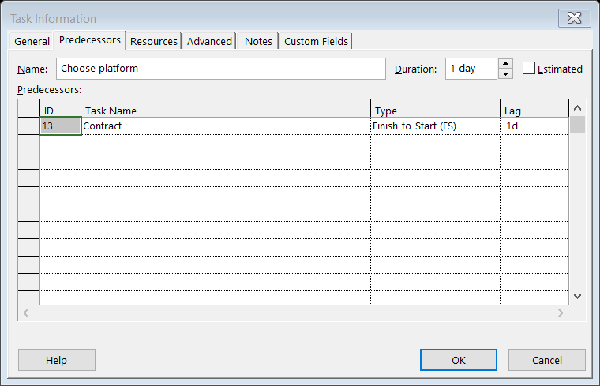
9

Slide 15
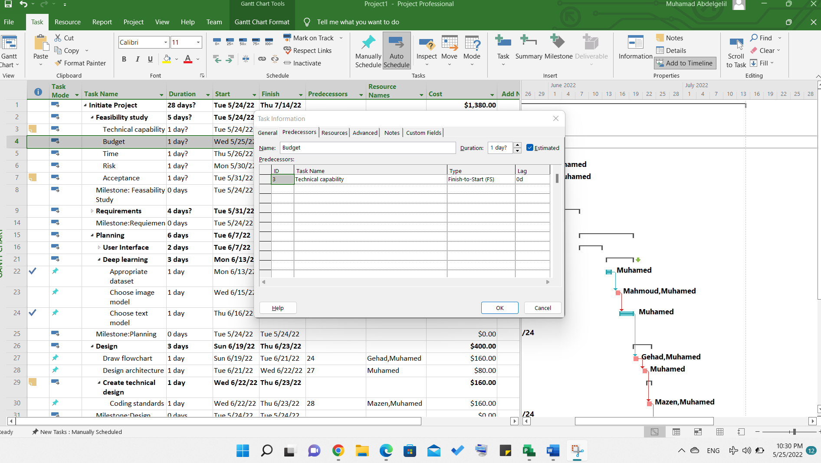
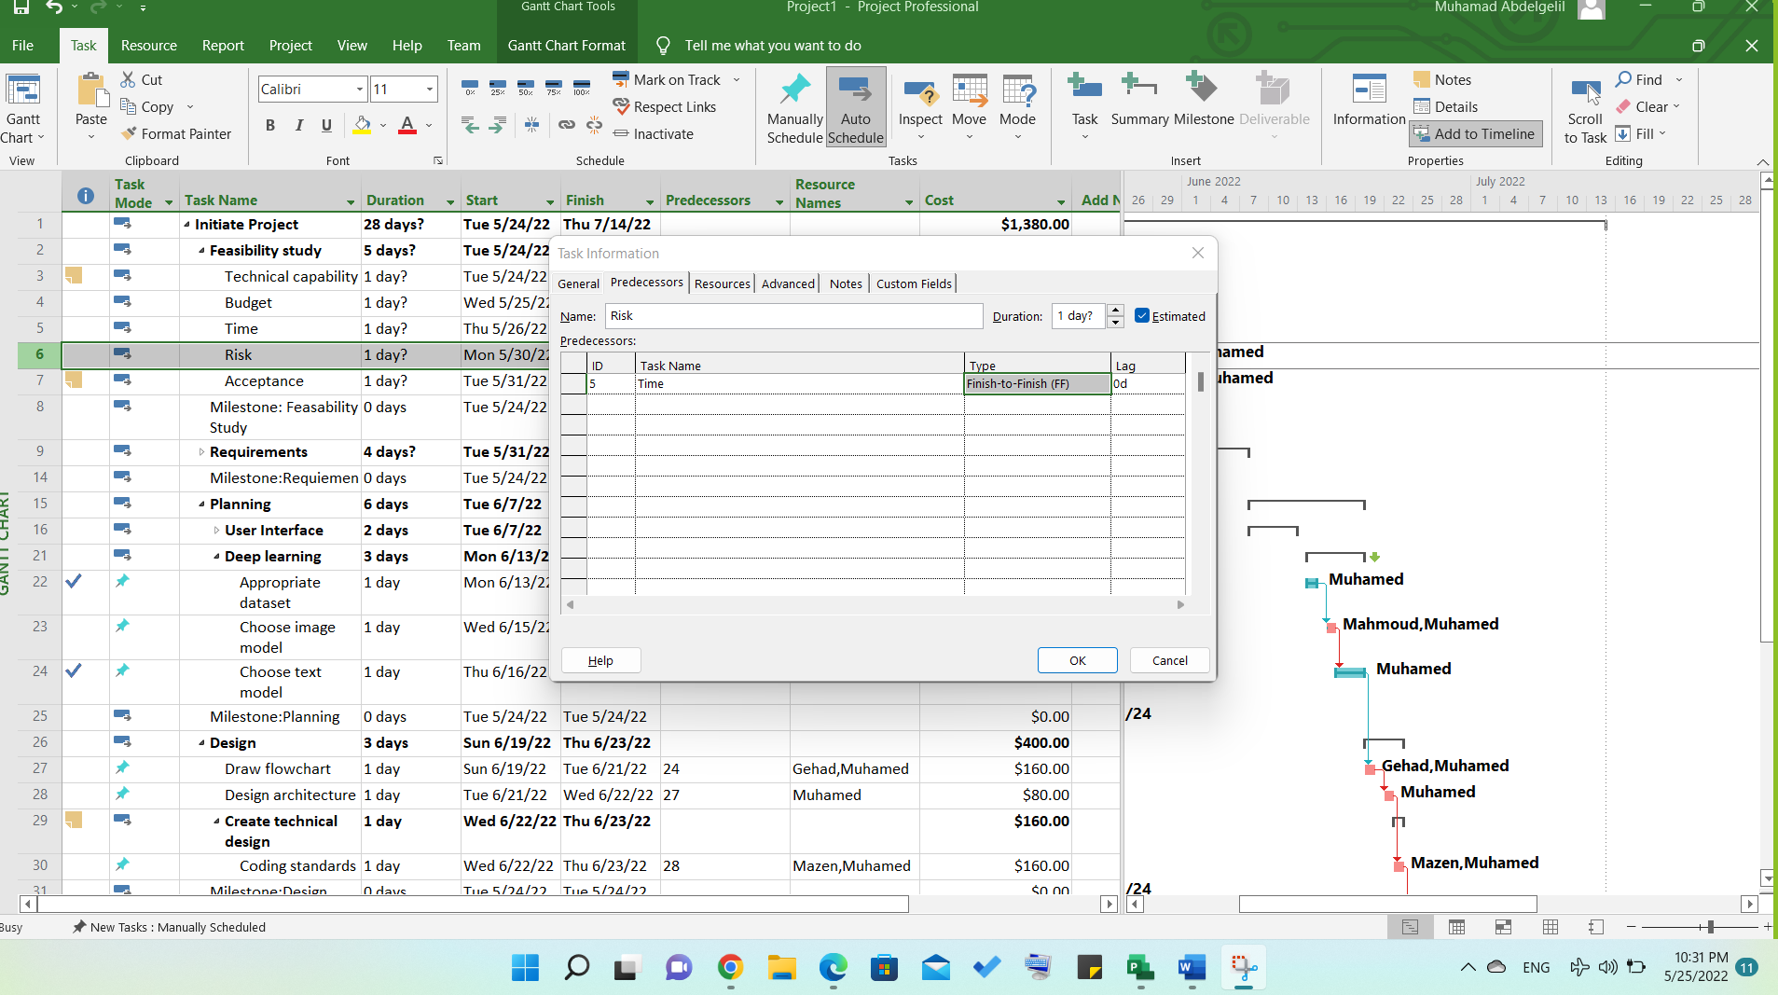
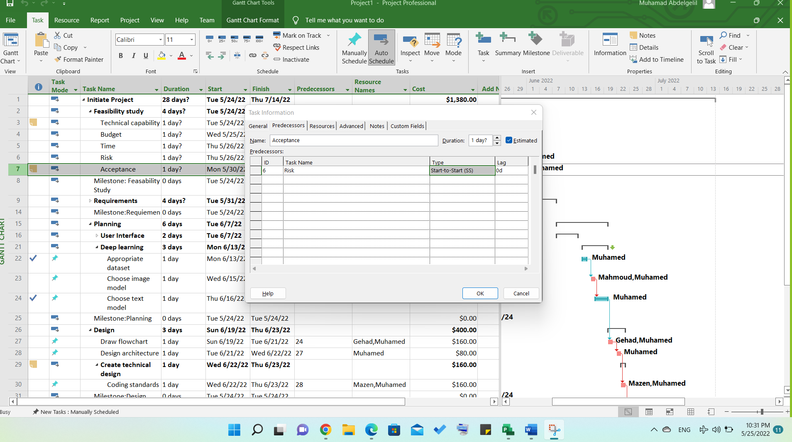
10

Slide 16
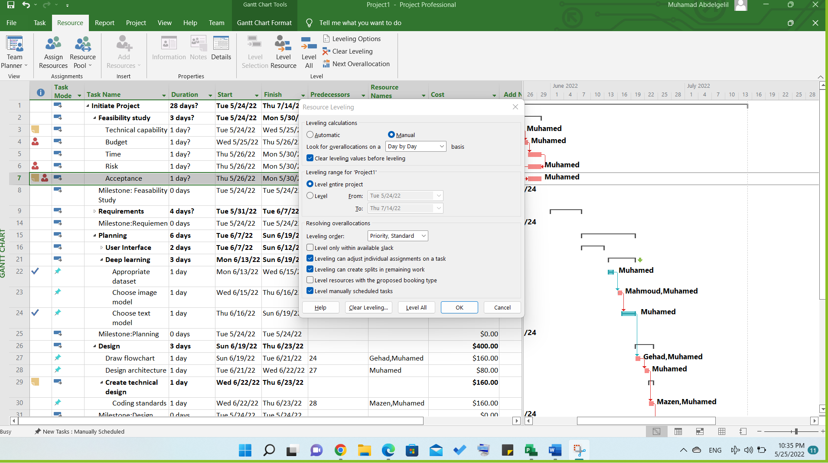
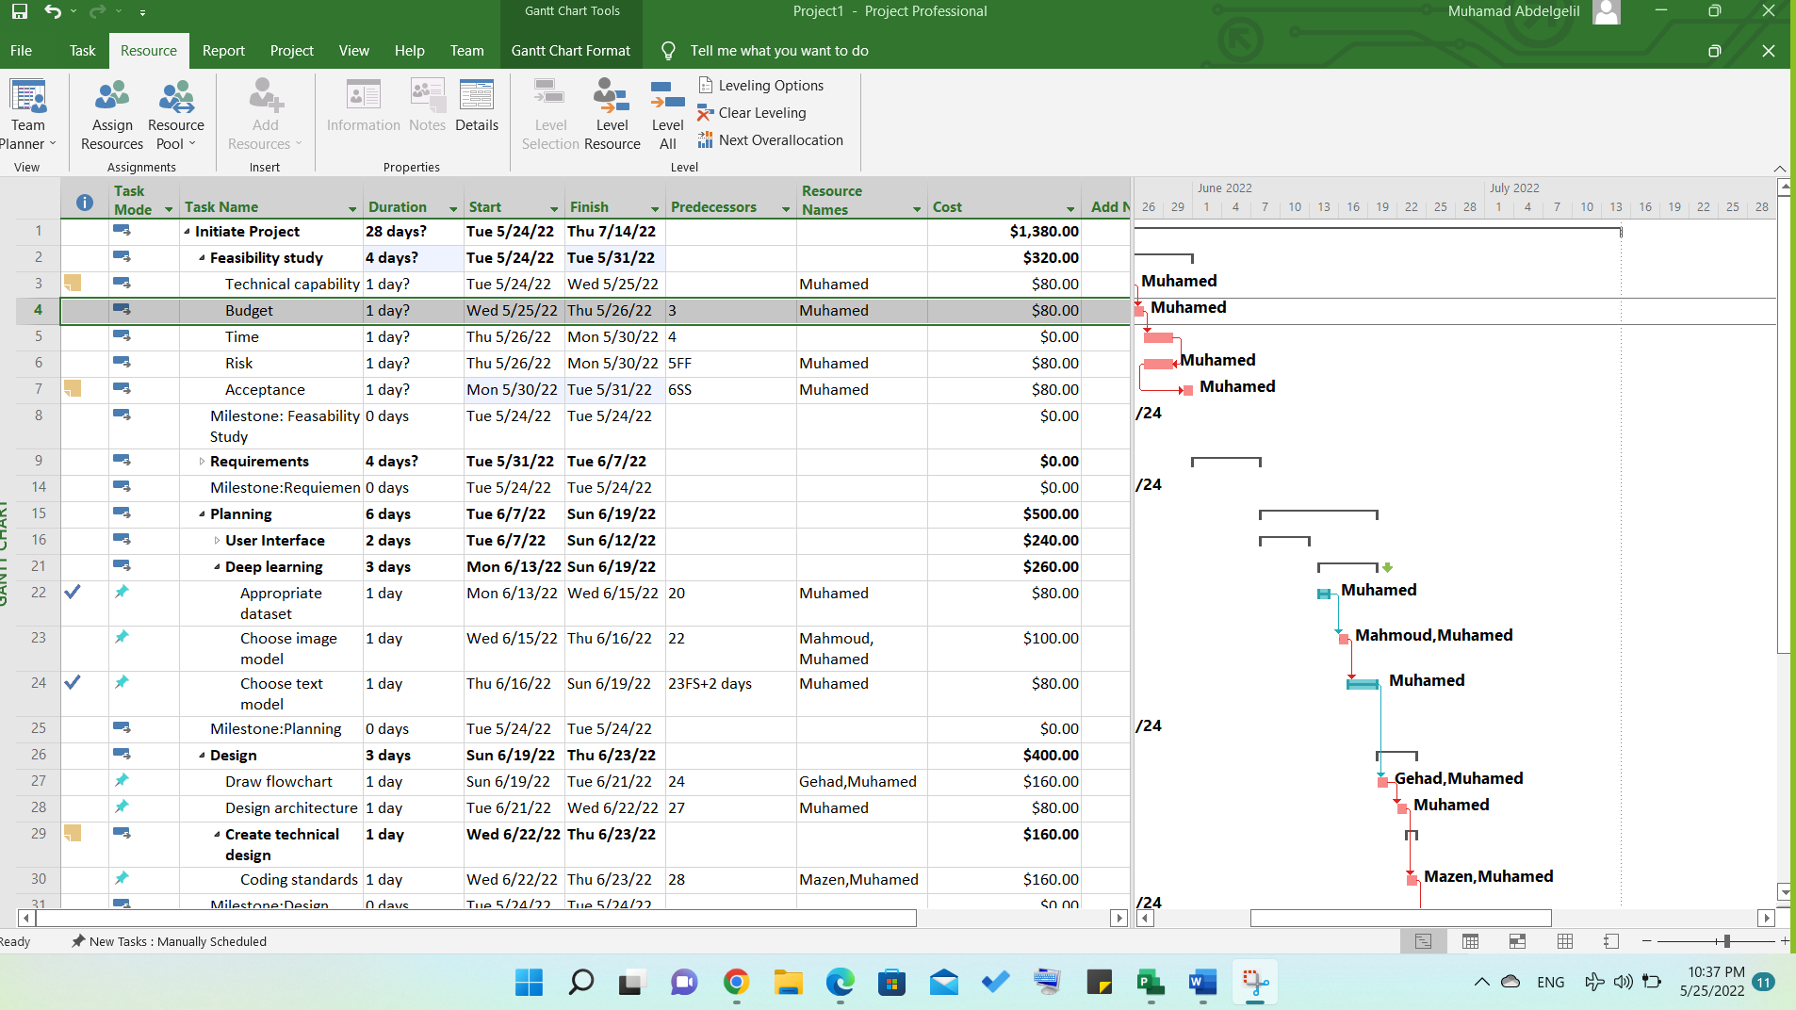
11

Slide 17
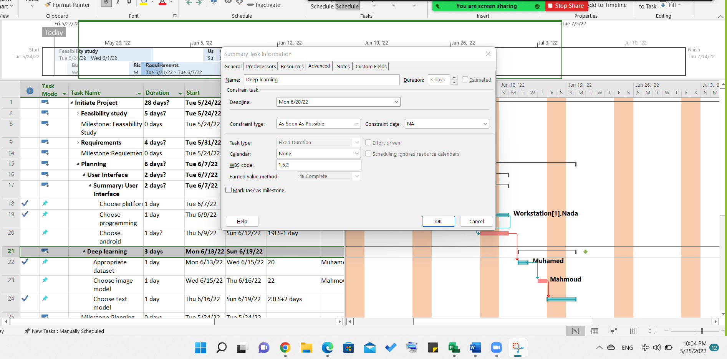
12

Slide 18
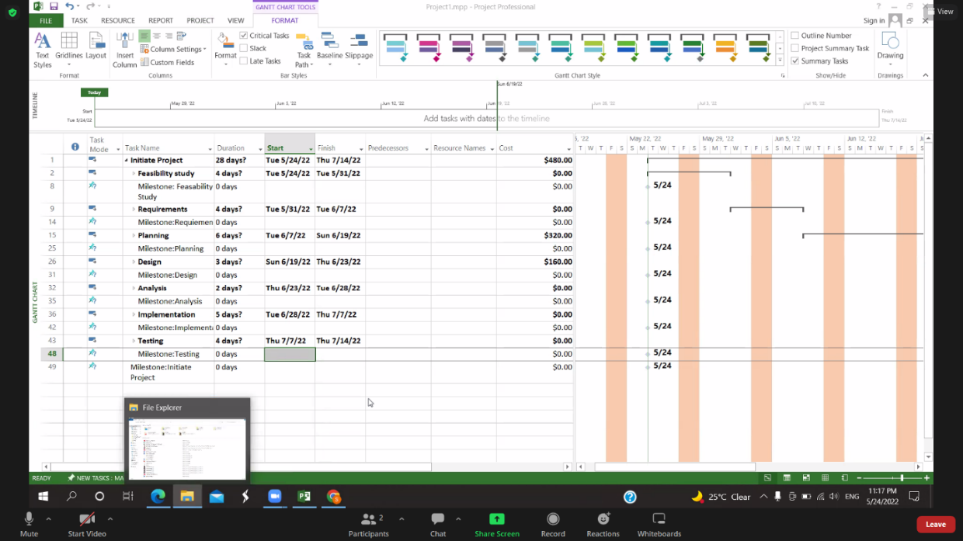
13

Slide 19
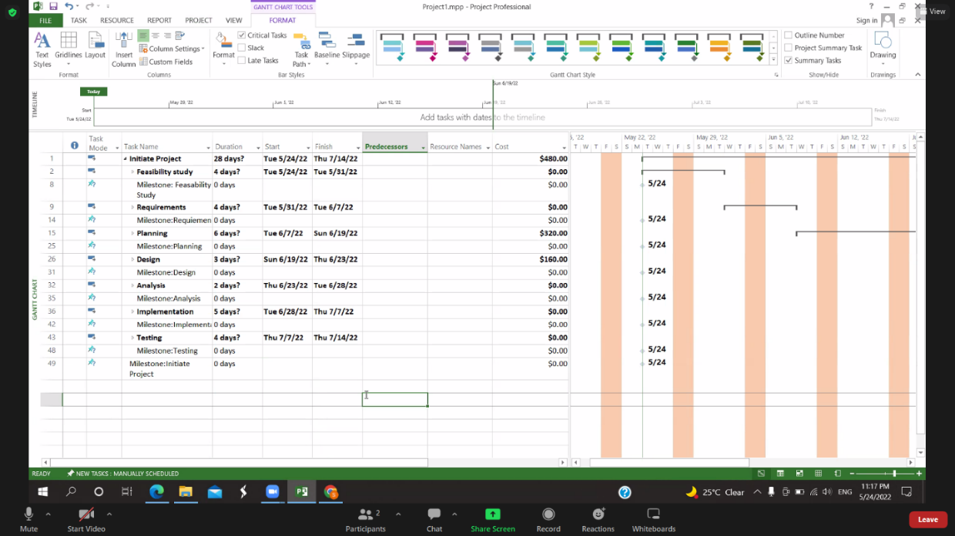
14

Slide 20
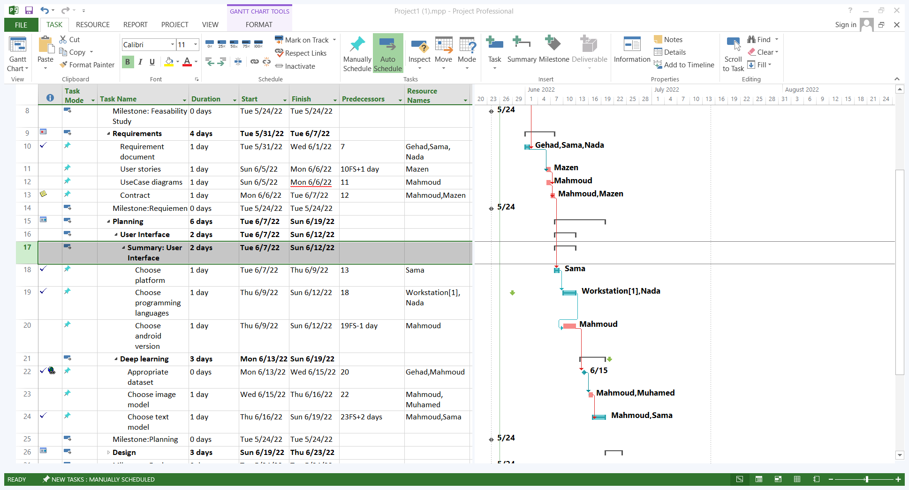
15

Slide 21
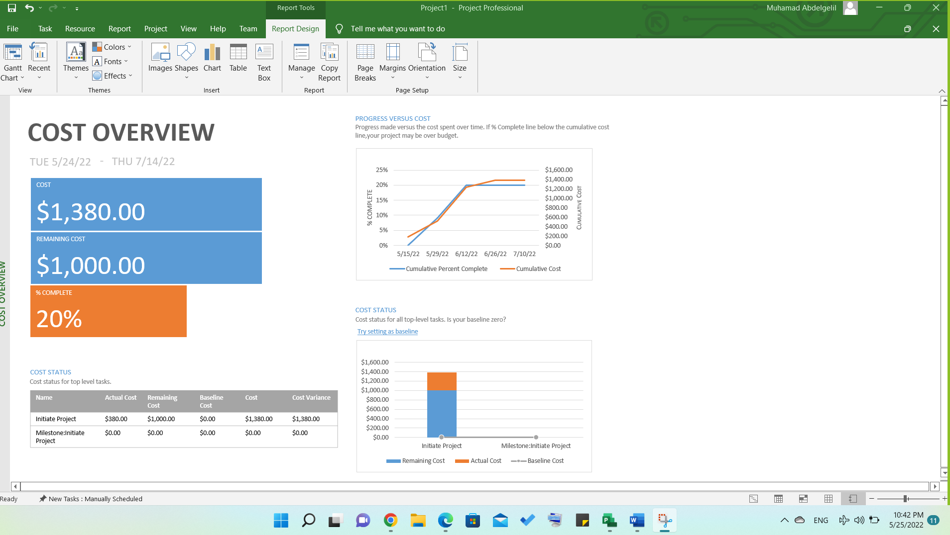
16: Cost Overview

Slide 22
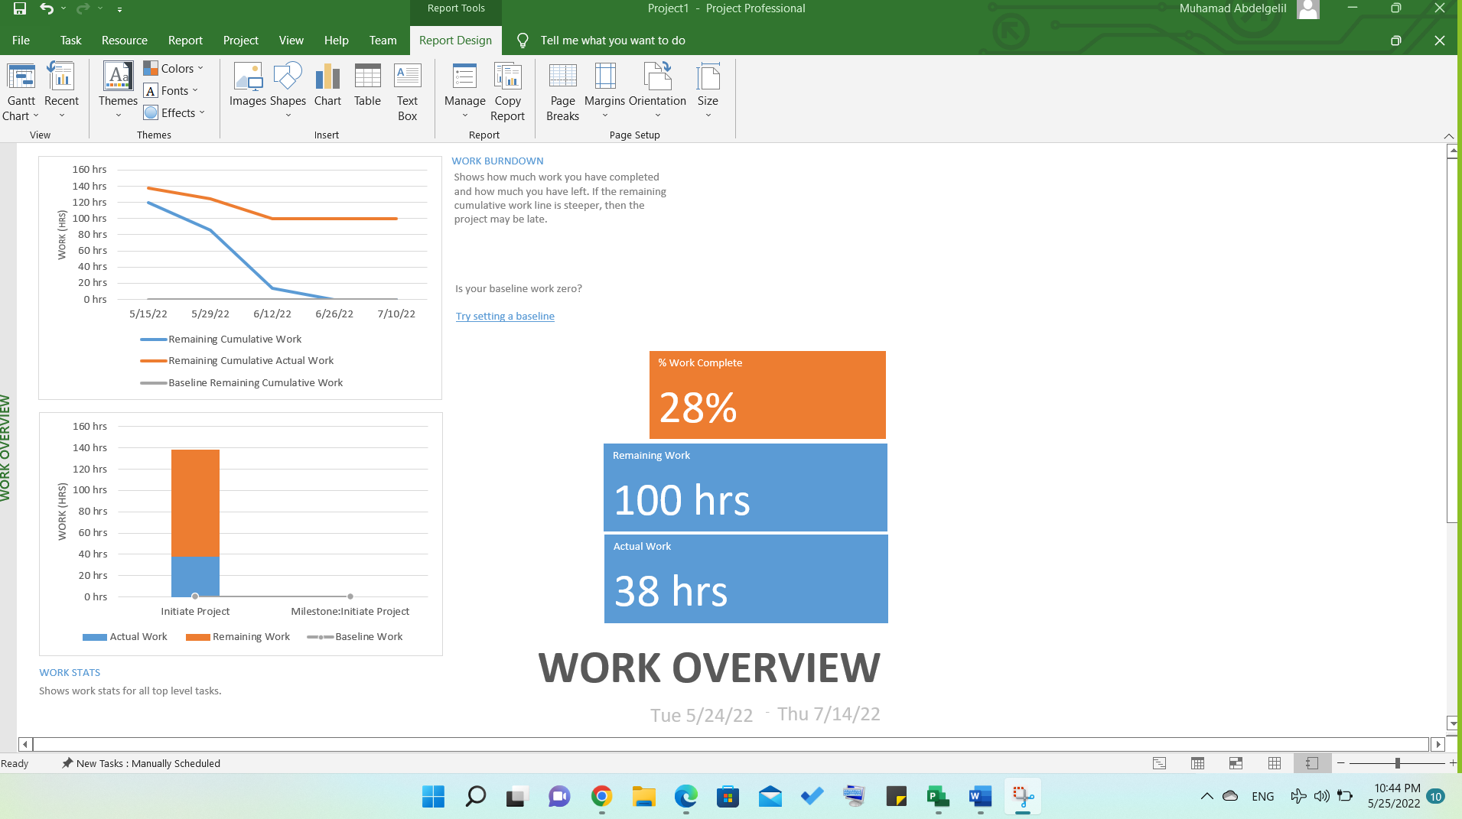
16: Work Overview

Slide 23
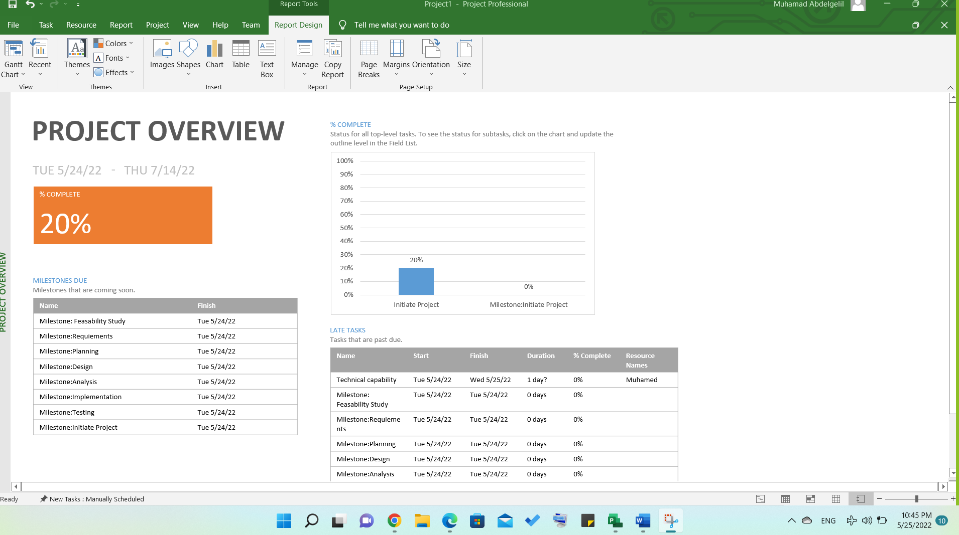
16: Project Overview

Slide 24
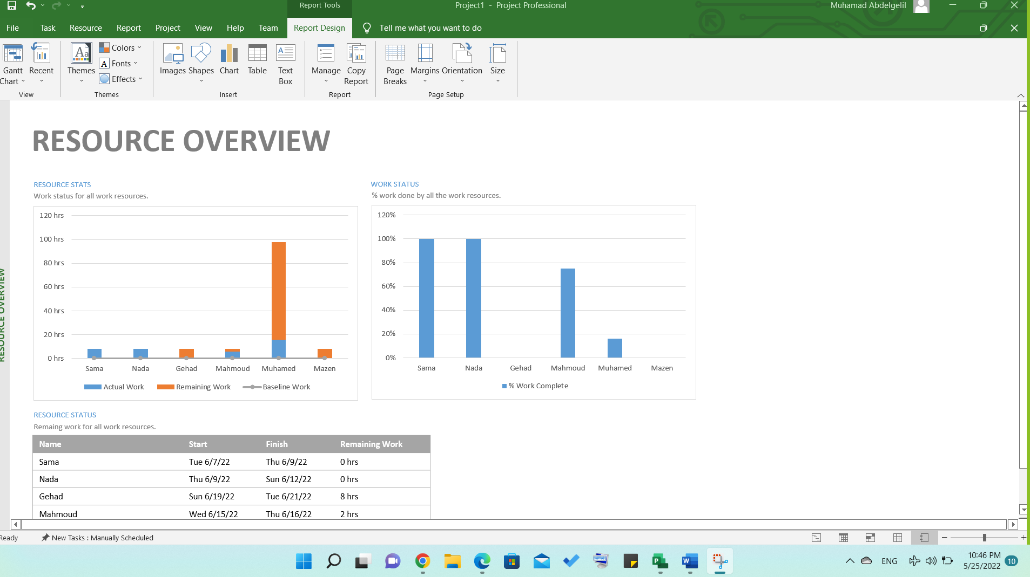
16: Resource Overview

Slide 25
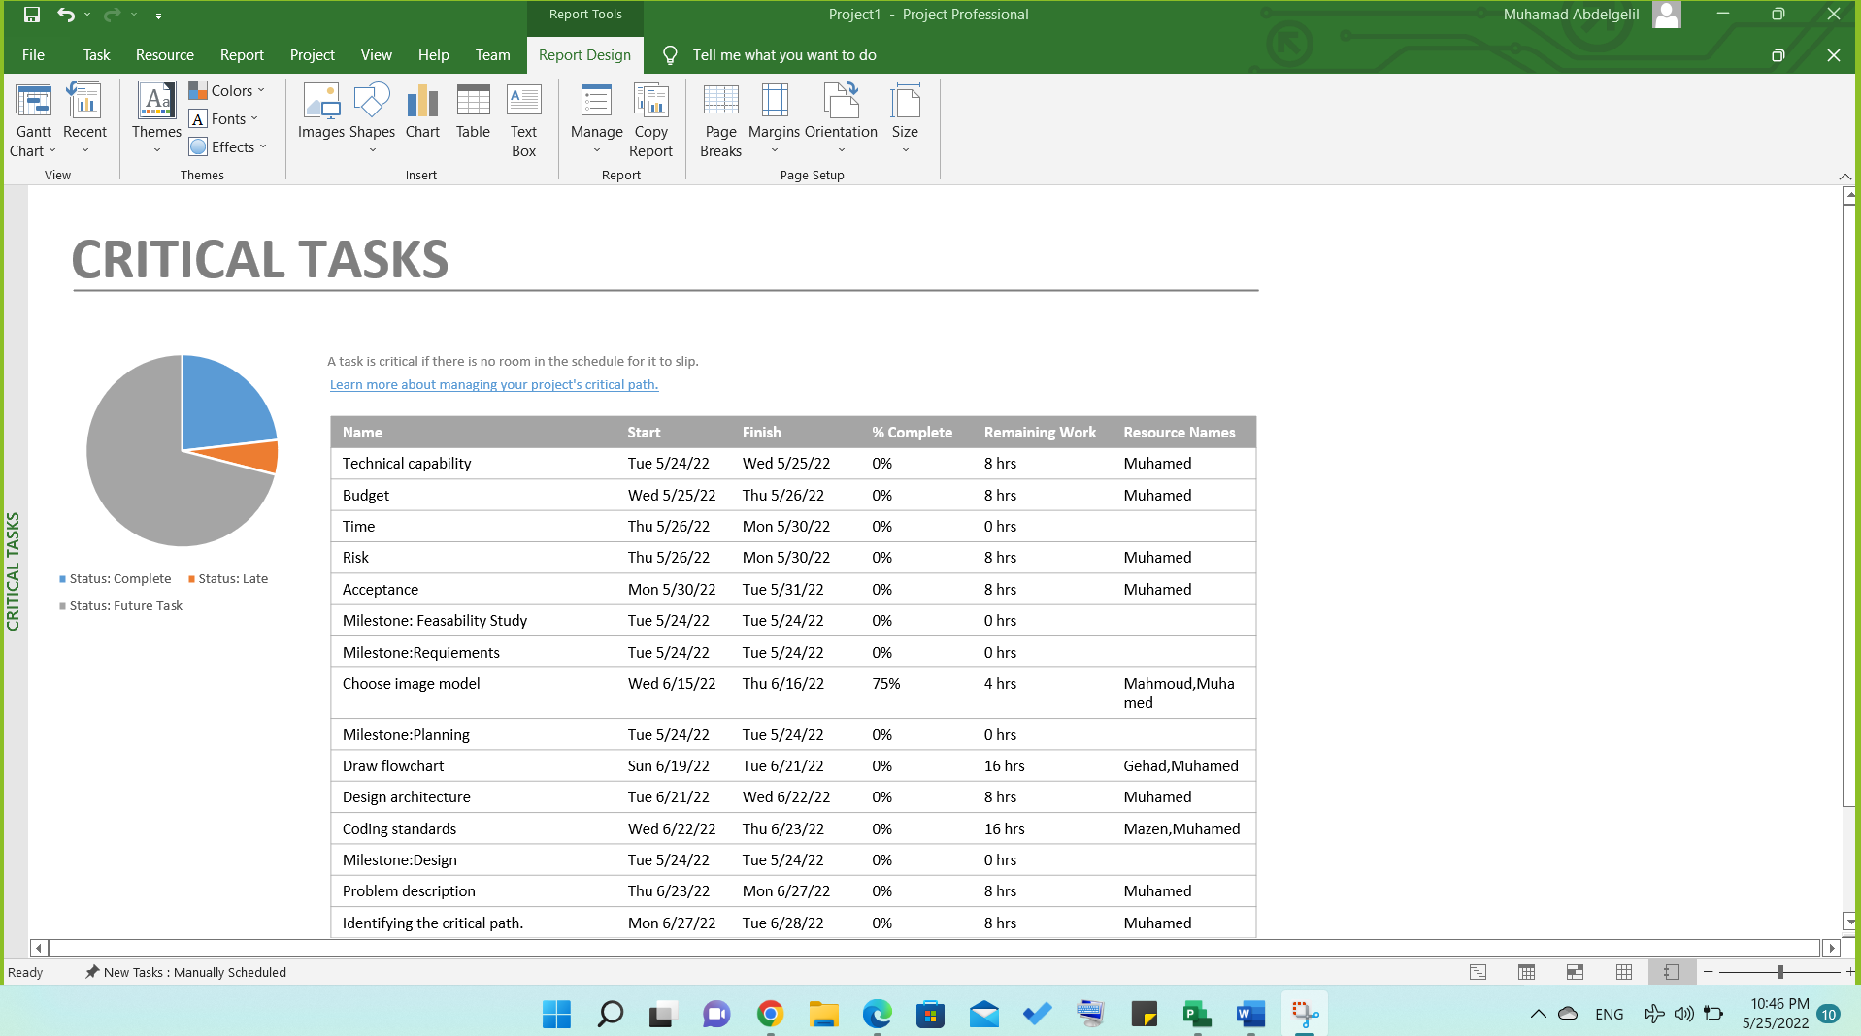
16: Critical Task

Slide 26
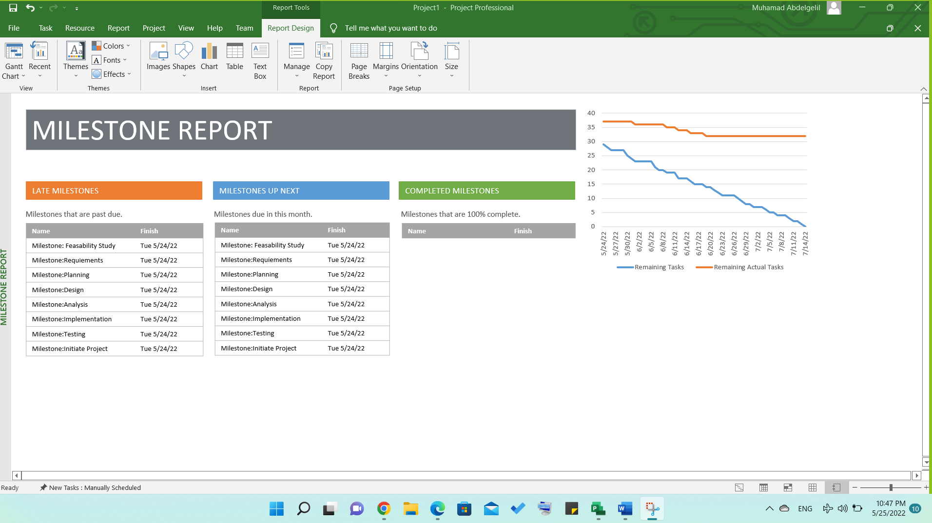
16: Milestone Report

Slide 27
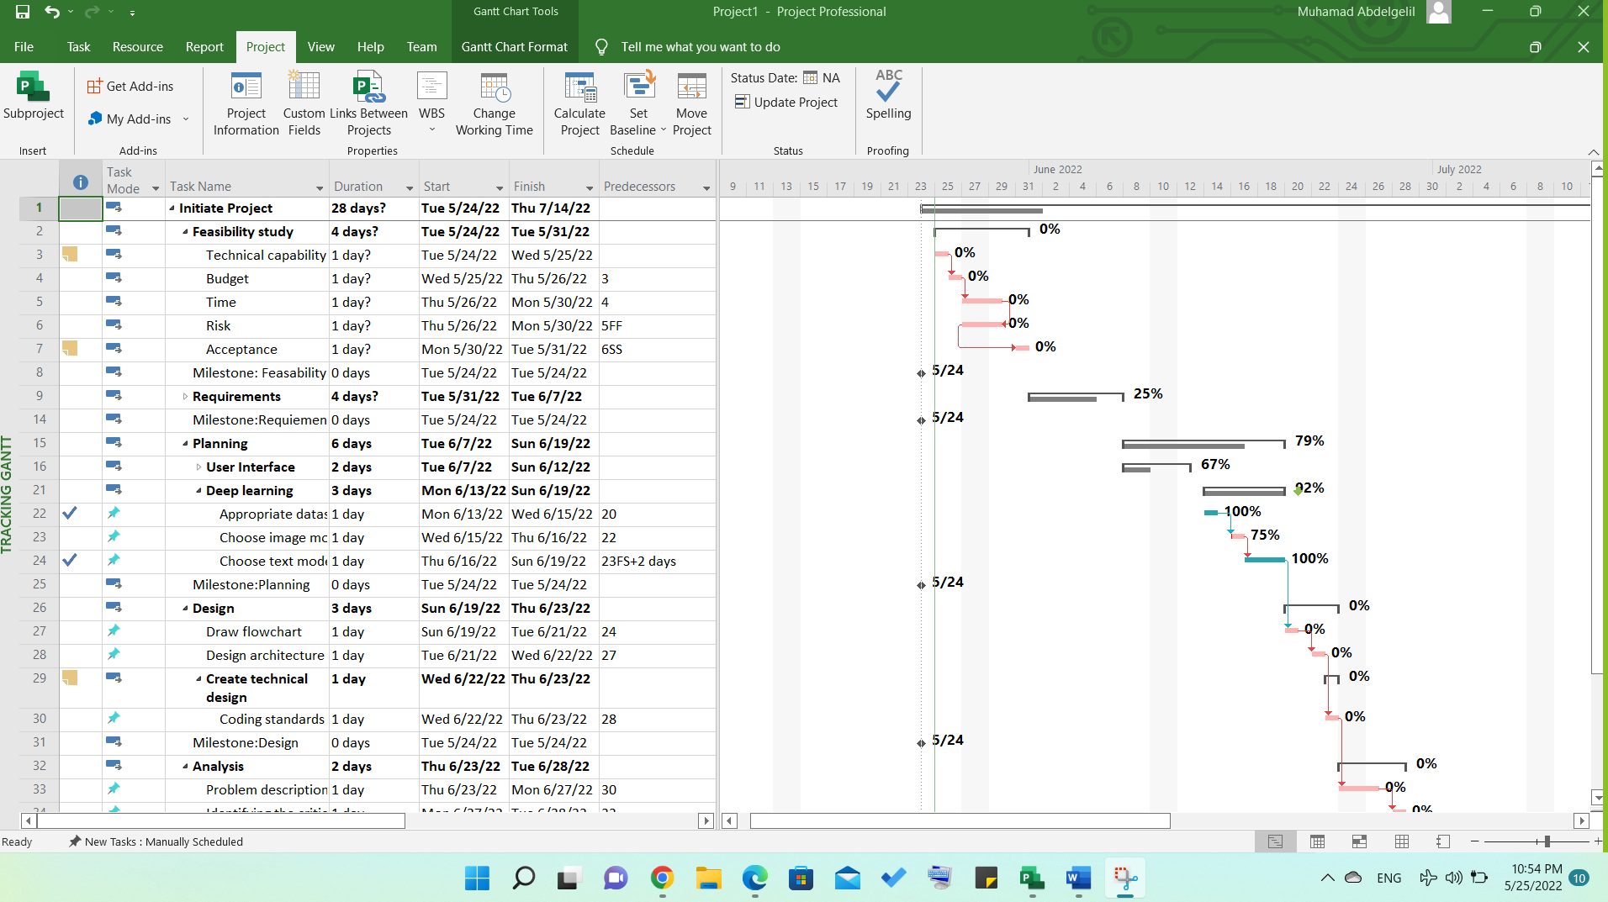
17: Before Baseline

Slide 28
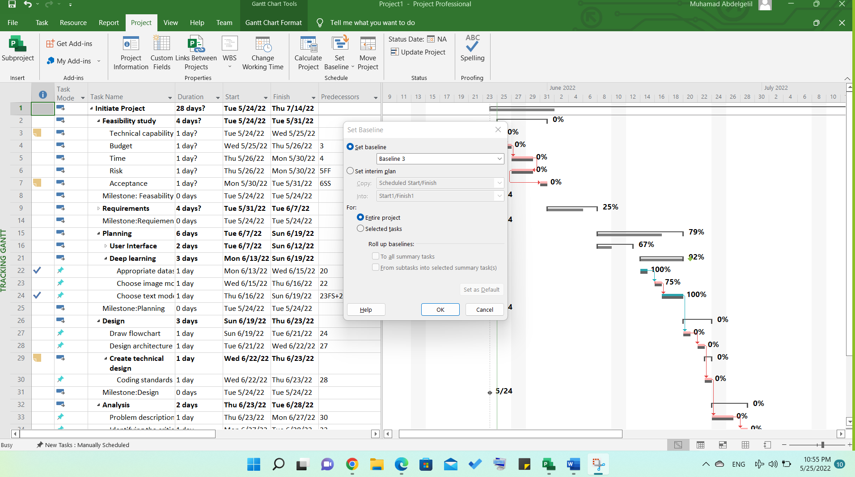
17: After Baseline

Slide 29
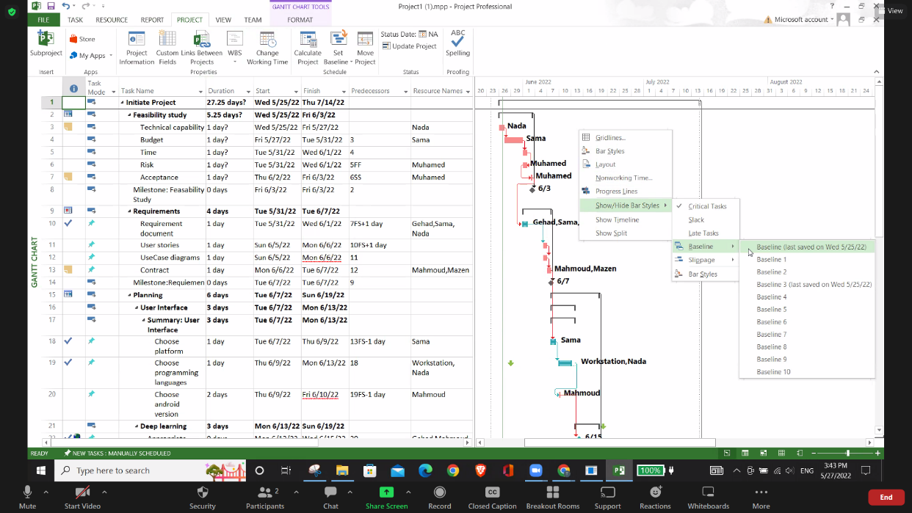
17: After Baseline

Slide 30
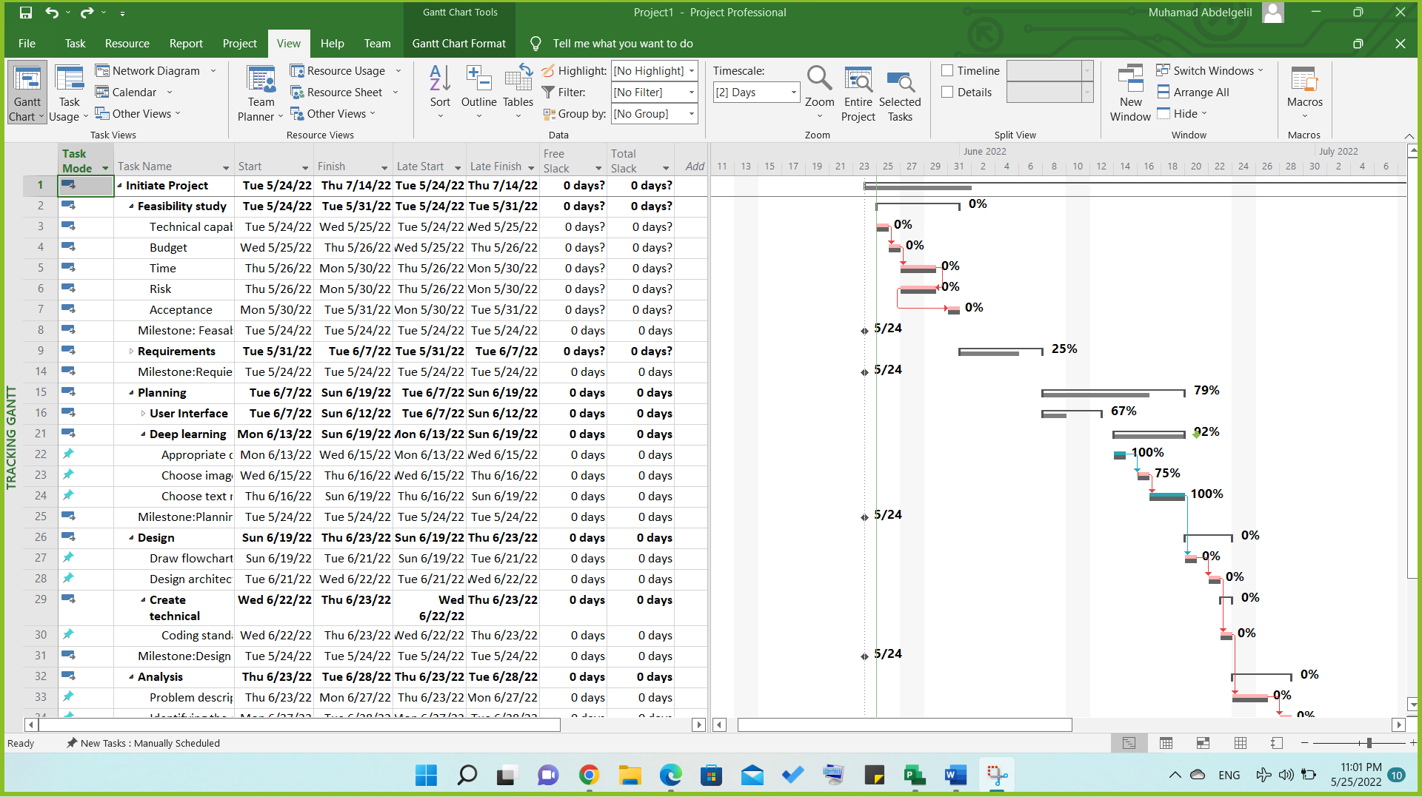
18

Slide 31
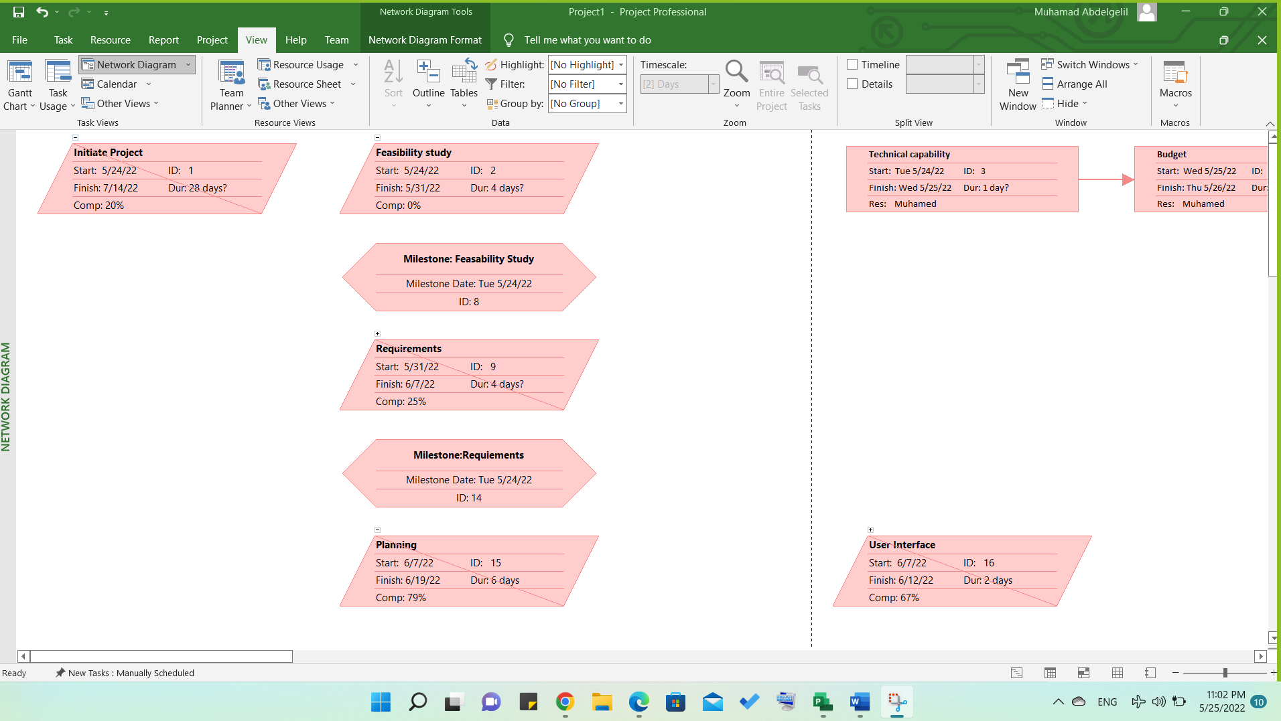
19

Slide 32
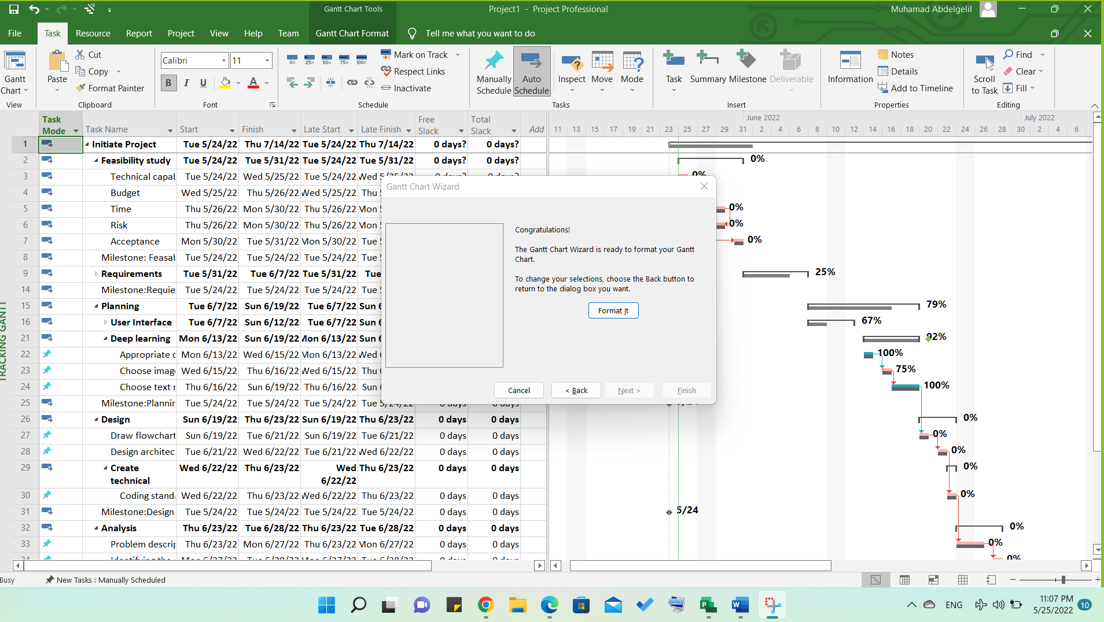
20: Grantt Chart Wizard

Slide 33
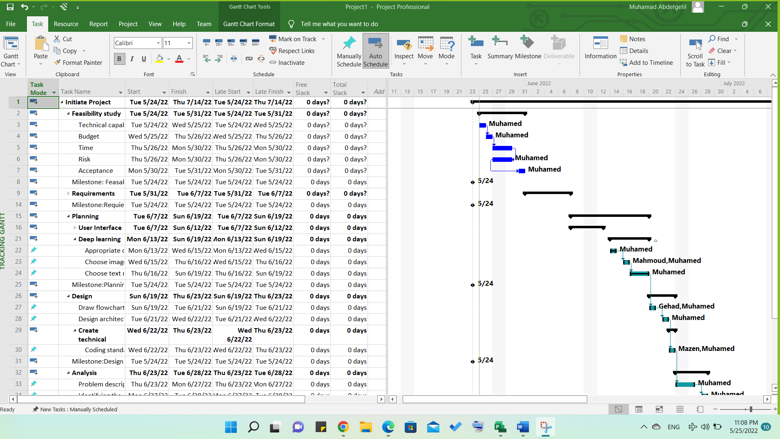
20: Format Grantt Chart

Slide 34
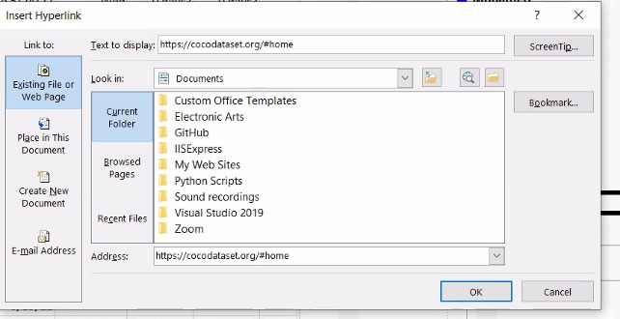
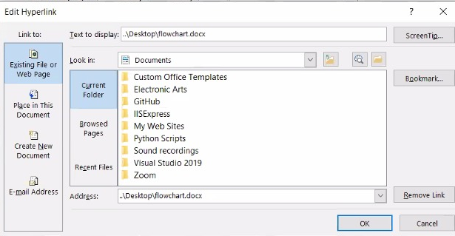
21

Slide 35
Thank You

